Slide 1
Trauma – Part 2

Slide 2
fractures

Slide 3
Pathophysiology
Bone healing
Primary
When fracture gap is small and minimal motion between fracture fragments
Anatomical reduction and rigid fixation (ORIF)
New vessel cross fracture gap and bone remodelling occurs across gap with little callus formation
Reuires blood supply
Secondary
Three phases
Inflammatory phase – bleeding from vessel at time of injury → blood clot forms → clot releases cytokines and growth factors which recruits inflammatory cells (DAY 7)
Reparative phase – fibroblasts lay down type 2 collagen → chondrocytes mature and begin chondrogenesis (DAY 14) → callus forms which bridges fracture ends → soft callus mineralises to become hard (mediated by osteoblasts) → neovascularisation occurs → ossification continues and callus becomes woven bone
Remodelling phase – converts woven bone to lamellar bone (takes many years)
Delayed bone healing
Failure of instrumentation (after internal fixation)
Delayed union – persisting pain, motion, hypertrophic callus formation, persisting fracture gap
Factors affecting bone healing:
Systemic – diabetes, vascular insufficiency, malnutrition, NSAIDs
Local – infection, poor immobilisation, loss of blood supply
Systemic effects of trauma
Inflammatory response – rise in cytokine levels
Can trigger ARDS

Slide 4
Classification
Fracture pattern related to age
Children = growth plates vulnerable → greenstick fracture, physeal injury
Young adult = ligaments → fractured scaphoid, scaphoid ligament injury
Older adult = weak bones → colle’s fracture
9 things when describing fracture
General features – patient details
Anatomical site
Type
Traumatic – mechanism of injury
Stress – develop slowly due to repetitive loads
Pathological – low energy injuries; weak bones caused by another pathology (osteoporosis, Pagets)
Intra-articular or extra-articular
Joints (congruent, subluxed, dislocated)
Physeal injury
Fracture pattern (simple/wedge/multifragmentary)
Deformity and displacement (rotational, shortening, translation, angular deformity)
Associated soft tissue injuries (skin, muscle, open/closed, neurovascular status)
11 things to say about XR – always get 2 views! (MRI used in hip fracture when XR not conclusive)
Check patient details
Name location and XR view
Describe obvious abnormality
Describe fracture
Site
Pattern – transverse/oblique/spiral/complex
Comminution – simple/wedge/complex
Special features
Displacement
Angulation (tilt)
Axial rotation
Associated features – dislocation, soft tissue swelling

Slide 5
Principles of Management
Resus
ATLS, temporary splint, reposition if overlying skin at risk, if open give abx and take photos
Reduce
Required if slight displacement in functionally vital area or significantly displaced/angulated/rotated
Not if undisplaced/risk outweighs benefit
Process
Closed – manipulation under anaesthesia
Open reduction – if internal fixation required/fracture is open
Continuous traction – used in cervical spine injuries
Restrict
Non-rigid support – slings/collar and cuff
Immobilisation with cast – plaster slab changed with lightweight cast after swelling subsides
Internal fixation – compression plates/IM nails
Indications: fractures requiring open reduction, unstable fractures, intra-articular fractures, multiple injury patient
Advantages: absolute stability, primary bone healing, earlier discharge
Complications: infection, failure of fixation
External fixation
Advantages: rapid, stabilises comminuted fractures
Complications: pin-track infection, delayed union
Consideration of soft tissue injuries
Open fractures – swab, photo, dressing, abx, tetanus, lavage under GA
Crush inujury – compartment syndrome
Rehab

Slide 6
Complications
Early general
Hypovolaemic shock – due to blood loss
DIC – causes consumption of clotting factors resulting in uncontrolled bleeding, Tx = platelets and clotting factors
SIRS – pyrexia, tachycardia, tachypnoea, high WCC
Fat embolism – long bone fractures; petechial rash + confusion + hypoxia, embolism of microvasculature by fat globules
Early local
Artery/nerve injury – GET DIAGRAMS OF NERVE AND ARTERY INJURIES PAGE 512
Neuropraxia = condution block that resolves, axonotmesis = axon divided and may recover, neurotmesis = axon and nerve sheath divided, little chance of recovery
Compartment syndrome
Infection – cellultis (group b strep), gas gangrene (shock, discoloured limb, caused by clostridium that produces CO2 in wound, requires debridement), tetanus (flu like symptoms caused by toxin production, requires debridement and abx, prophylaxis if >10 years since last dose), necrotising fasciitis (infection of dermis, s pyogenes, requires debridement and abx)
Soft tissue compromise – need to cover via closure/graft
Late general
DVT
PE
UTI
LRTI
Disuse atrophy
Psychosocial
Late local
Delayed union/non-union
Infection
Stiffness
Osteoarthritis
Avascular necrosis – commonly femoral head, proximal scaphoid, humeral head, body of talus; pain + chondrolysis + articular collapse; requires revascularisation
Myositis ossificans – calcification within muscle, sites = quadriceps, gluteals, biceps; tx = NSAIDs
Complex regional pain syndrome
Type 1 – pain + stiffness + swelling + colour change (red); SELF LIMITING, requires physio and analgesia
Stages: 1 (pain and tenderness) → stage 2 (cool and sweaty) → stage 3 (stiffness and osteoporosis)
Type 2 - type 1 with assocaited nerve lesion; requires PREGABALIN

Slide 7
Common fractures

Slide 8
Upper Limb
Elbow - complications (reduced ROM, prolonged immobility, posterior interosseous nerve damage, myositis ossificans, ulnar nerve damage)
Adult supracondylar fracture
Tx: conservative, ORIF if displaced
Intercondylar fracture
Tx: conservative, immobilise
Olecranon fractures (immobilisation/screw or plate fixation)
Coronoid fracture
Simple avulsion/half of coronoid/more than half coronoid
Tx: conservative, IF
Radial head fractures (immobilisation, ORIF)
Radial neck fracture
Common in children
Tx: immobilisation, MUA if angulation, ORIF if dislocated
Radial/ulnar fractures
Monteggia fracture – fracture of proximal ulnar with dislocation of radial head, requires ORIF
Galeazzi fracture – fracture of shaft of radius with dislocation of distal ulna, requires ORIF
Forearm bone shaft fractures – requires MUA
Complications: compartment syndrome, non-union, synostosis, malunion, refracture
Lower radius
Colles’: dorsal and radial displacement of distal fragment (DINNER FORK)
Tx: reduction via MUA
Risk of carpal tunnel syndrome
Bartons: fracture of dorsal lip of distal radius and subluxation of carpus
Smith’s: distal radial fracture with volar displacement
Wrist
Scaphoid: at risk of AVN, tx = immobilise
Dislocation of lunate: requires ORIF, risk of median nerve injury
Shoulder and humerus
Anterior shoulder dislocation
More common
Pain, loss of sensation over badge area if axillary nerve damaged
Tx: reduce (under GA – TEAR (traction, external rotation, adduction, rotation (internal)), rehab
Posterior shoulder dislocation
Light bulb sign on XR
Tx: reduce (traction and external rotation), rehab
Clavicle fracture
Junction of middle and outer thirds
Types:
Subluxations/dislocations
Greenstick fracture – children
Undisplaced – conservative treatment only
Displaced
Non-union – indication for internal fixation
Humerus fracture
Anatomy: surgical neck → axillary nerve; spiral groove → radial nerve; medial epicondyle → ulnar nerve
Proximal fractures (surgical neck/greater tuberosity/lesser tuberosity) - described by how many parts involved
Neer’s classification
Tx: conservative, ORIF if complicated
Shaft fractures – associated radial nerve damage
Tx: conservative, ORIF if complicated

Slide 9
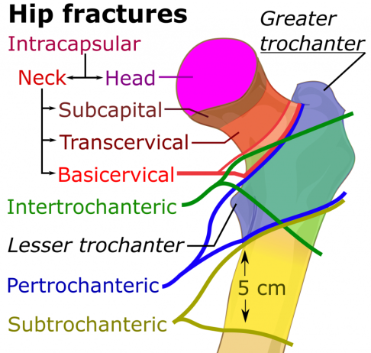
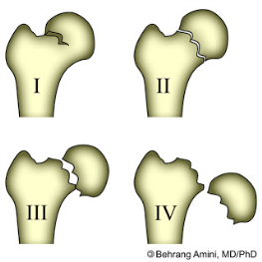
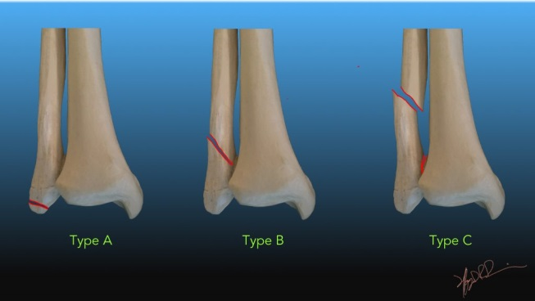
Lower Limb
Proximal femur
Children = SUFE, elderly = #NOF
At risk of AVN (retinacular vessels disrupted in intracapsular fractures)
Types:
Intracapsular – subcapital, transcervical, basicervical
Garden’s classification (1 and 2 undisplaced, 3 and 4 displaced)
Tx: 1 and 2 screw, 3 and 4 – GET RHYME FROM FINALS NOTES
Extracapsular – intertrochanteric, subtrochanteric, basal
Tx: reduction and fixation (dynamic hip screw/IM fixation)
Femoral shaft
Risk of high blood loss and fat embolism
Reduce early (ATLS), definitive treatment = IM nail
Distal femoral fractures
Trauma/osteoporosis
Tibia/fibula fractures
Tibial plateau – Schatzker classification, more commonly lateral plateau, requires fixation
Tibial shaft +/- fibula fracures – conservative treatment
Ankle
Weber-AO classfication
Type A/B/C
Tx: conservative, fixation if displacement

Slide 10
Pelvic Fractures
Pelvic
Usually breaks in 2 places (polo mint)
Classification
Young and Burgess – mechanism of injury
Tile – stability of posterior arch
XR first line then CT
Tx: temporarily stabilised with external fixator
Acetabular fractures
Risk of sciatic nerve injury
Tx: non-surgical unless displaced

Slide 11
Thoracolumbar Spinal Injuries
Due to osteoporosis/RTAs
Classification: ASIA score
Denis’ three column description
Spine has 3 weight bearing columns (anterior, middle, posterior)
Magerl two column description
Spine has anterior and posterior column
Tx: prevent further neuro injury, prevent deformity, restore function

Slide 12
Cervical Spine Fractures
Immobilise in ATLS until fracture excluded via 3 view XR
Important injuries
Jeffersons – burst fracture of C1
Odontoid peg fracture
Hangmans fracture – pars fracture C2
C3-C7 injuries
Facet joint dislocation
Clay-shovellers fracture
Tx: rigid collar, fusion/internal fixation

Slide 13
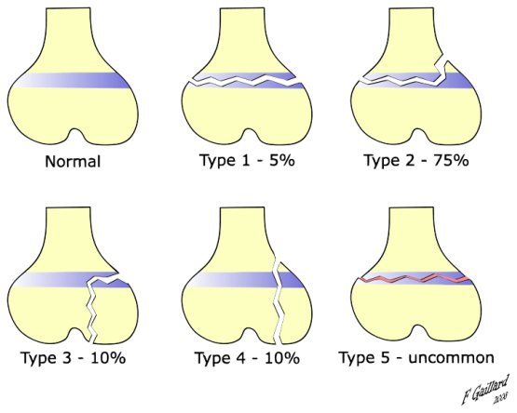
Fractures in Children
Paediatric bone - higher water content, lower mineral content, greater elasticity, weaker ligaments, injuries due to compression, bending (greenstick) and torsion (epiphyseal injuries)
Epiphyseal injuries – requires MUA
Salter Harris classification
Type 1
Type 2 – most common
Type 3 – requires reduction and fixation
Type 4
Type 5 – disrupts growth
Forearm bone fractures
Fall on outstretched hand causing distal radius/ulna fractures
Greenstick = incomplete fracture, requires MUA
Torus fracture = due to compression, requires analgesia
Supracondylar fractures
Just about elbow, caused by fall on outstretched hand
Risk of damage to median nerve, radial nerve, brachial artery and development of compartment syndrome
Signs of brachial artery damage = pain on finger extension, excessive bruising, loss of distal pulses, weakness, gangrene of digits
Tx = immobilise, MUA to protect ulnar nerve if displacement
Condylar fractures
Lateral condyle
Femoral fractures - ?NAI
Tx = reduction with skin traction and thomas splint

Slide 14
Soft tissue

Slide 15
Injuries
Knee injuries
Ligaments
Extra-articular
Medial collateral – blow to lateral aspect of knee
Lateral collateral – forms attachments to tibia, fibula and patella which can all be damaged, common peroneal nerve may be damaged (weakness of dorsiflexion of foot)
Intra-articular
Posterior cruciate – tibia struck and forced backwards with knee flexed (RTAs), posterior sag tests this injury
Anterior cruciate – twisted over slightly flexed knee with foot flexed, tx – physio
Serious ligamentous injury vs strain
Menisci
Rotation of tibia on femur in flexed weight bearing knee
Medial more common
S: locked knee (requires semi-urgent arthroscopy), haemarthrosis, joint line tenderness, clicking, medial/lateral pain
Extensor apparatus
Direct violence
S: unable to extend knee, swelling, bruising, palpable gap above patella, displacement of patella
Tx: surgical repair of tendon ruptures, ORIF if displaced
Ankle injuries
Inversion – damage to lateral ligament, sprain → complete tear
Eversion – medial ligament, avulse medial malleolus
Forced dorsiflexion – lateral displacement of fibula and lateral drift of talus
Achilles tendon rupture – degenerative changes to tendon
Sudden pop and intense pain, palpate defect then palpate again when patient standing on tiptoes
Tx: conservative or surgical repair of tendon

Slide 16
Compartment Syndrome
Inadequate tissue perfusion and oxygenation in a compartment secondary to raised pressure within compartment
Commonly anterior compartment of lower limb
Pathogenesis
swelling within a compartment due to oedema/inflammation impedes venous outflow which increases pressure further prevent flow of oxygenated blood causing muscle ischaemia, causing necrosis
S: pain out of proportion to injury, muscle tenderness and compartment feels tense, pain on passive stretch, weakness/paraestheisa/pulses (LATE SIGNS)
Tx: remove bandages, surgical emergency – requires surgical decompression (fasciotomy – medial and lateral incisions which are left open and closed once swelling subsides)
High risk fractures for causing this = tibial shaft fractures

