Slide 1
The Breast

Slide 2
Embryology
Apocrine sweat gland
Ectoderm = epithelial lining of ducts and acini
Mesenchyme = stroma
Growth of ectoderm into mesenchyme at 4 weeks gestation
Breast develops from mammary ridge (from 5 weeks gestation) which extends from axilla to groin
Nipple has specialised epithelial cords with form lactiferous ducts
At puberty, these ducts proliferate and form breast bud

Slide 3
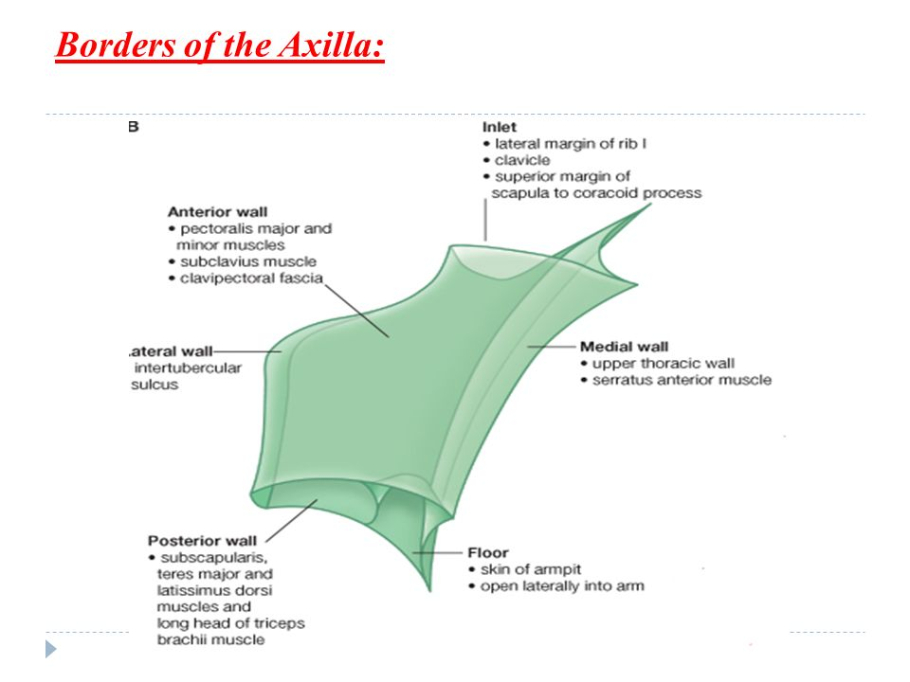
Contents of the Axilla
Brachial plexus
Axillary artery and vein
Axillary fat pad (20 axillary lymph nodes)
Intercostal brachial nerves
Long thoracic nerve
Thoracodorsal trunk

Slide 4
Axilla
Axillary artery
First branch = superior thoracic artery (supplies pectorals)
Second part has 2 branches
Thoracoacromial artery
Lateral thoracic artery
Third part has 3 branches
Subscapular artery
Anterior circumflex humeral artery
Posterior circumflex humeral artery
Axillary Vein
Becomes subclavian vein lateral to first rib
Lymph nodes (classified by anatomical level in traditional axillary clearance)
Level 1 = lateral to pec minor
Level 2 = posterior to pec minor
Level 3 = medial to pec minor
Supraclavicular nodes drain to thoracic duct on left, and right lymphatic duct on right

Slide 5
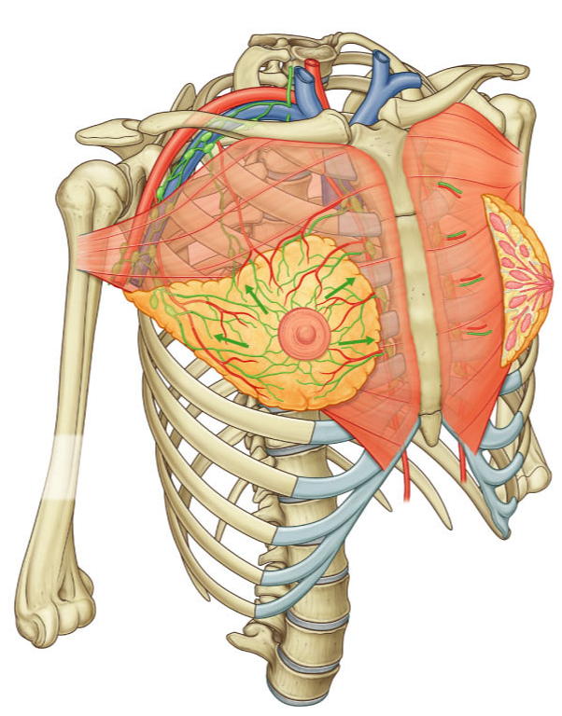
Position
Most prominent superficial structures of anterior thoracic wall
Inferior breast base rests on upper aspect of external oblique and rectus sheath and separated from these muscles by deep fascia
Extends from lateral border of sternum to mid-axillary line
Base lies between 2nd and 6th ribs
Nipple is in line with 4th rib interspace

Slide 6
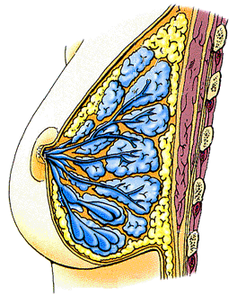
Position of the Breast
Intercostal muscles
Lie within the superficial fascia of the chest
2/3 overlying Pectoralis major
1/3 overlying Serratus anterior
2
Pectoralis minor
3
Retromammary space
4
Pectoralis major
5
Pectoral fascia
6
7

Slide 7
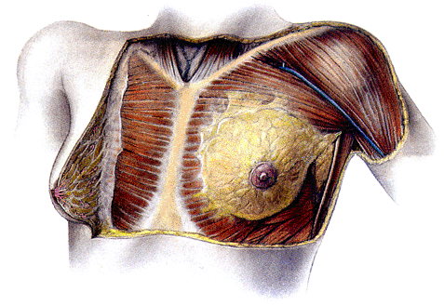
Position of the Breast
Pectoralis major
Fat lobules
Pectoral fascia
Retromammary space
Axillary tail
Suspensory ligament
Nipple
Areola
Lactiferous duct
Serratus anterior
Fat
Retro-mammary space: a layer of loose connective tissue separating the breast from the deep pectoralis fascia, providing some degree of movement over underlying surfaces.
Notes:
Areola appears rough because modified sebaceous glands open onto its surface.

Slide 8
Gross Structure of the Breast
Intercostal muscles
Fat
2
Suspensory ligaments
Pectoralis minor
Pectoralis major
3
Retromammary space
Lactiferous duct
4
Alveolus
Lactiferous sinus
Mammary gland lobules (non-lactating)
5
Mammary gland lobules (lactating)
Pectoral fascia
6

Slide 9
Structure of the breast lobes
15-20 independent lobes, each consisting of a gland, which open on to nipple
Lobules open into lactiferous ducts, which drain into lactiferous sinuses which store milk during lactation
Lobes embedded in adipose tissue
Sub-divided by collagenous septa
Lobes arranged radially around nipple- at different depths
Each lobe has lobules, alveolar ducts and secretory alveoli

Slide 10
Secretory lobe
A single lactiferous duct drains each lobe
Duct forms a dilatation, the lactiferous sinus, before opening onto the surface of the areola
Compression of the areola expresses milk drops which have accumulated in the sinus
Lactiferous duct
Lactiferous sinus

Slide 11
Blood supply
*Internal thoracic artery (ie mammary artery)
Branches of (**2nd part of) axillary artery:
Lateral thoracic artery,
Thoracoacromial artery (trunk)
Lateral perforating branches of intercostal arteries
*Arises from subclavian artery
** Those arising behind pectoralis major

Slide 12
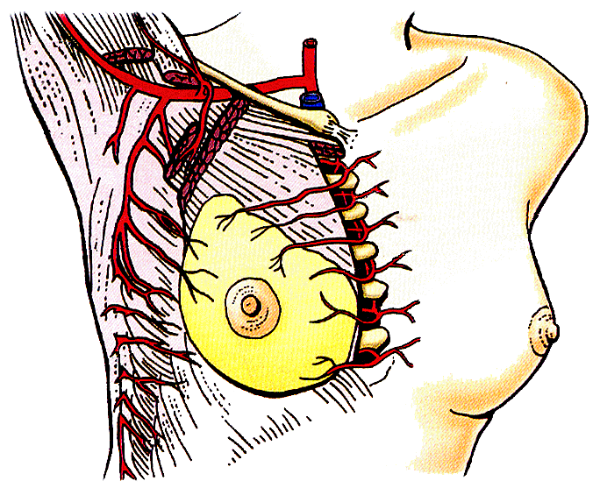
Arterial Supply of the Breast
Subclavian a.
*Axillary a.
Thoracoacromial trunk
*Internal thoracic a.
*Lateral thoracic a.
Medial mammary branches
(Superior) lateral mammary branches
Posterior intercostal aa.
Lateral cutaneous branches
(Inferior) lateral mammary branches

Slide 13
Venous drainage
Axillary vein (becomes subclavian v.)
Internal thoracic veins (terminates in brachiocephalic v.)
Posterior intercostal veins

Slide 14
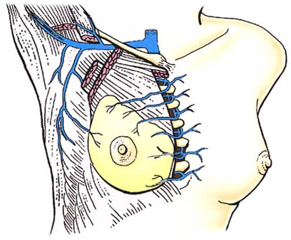
Venous Drainage of the Breast
Internal jugular v.
Subclavian v.
*Axillary v.
Lateral thoracic v.
*Internal thoracic v.
Lateral mammary vv.
Medial mammary vv.

Slide 15
Lymphatics
Axillary lymph nodes (75%)
Drain lateral side
Including: Humeral, Central, Pectoral and Subscapular
These drain to apical lymph nodes and subclavian lymphatic trunk via the clavicular nodes
Parasternal lymph nodes
Drain medial side
next drain to bronciomediastinal trunk (lymphatic vessel)
Some drainage to other breast (internal mammary nodes)
Left breast also drains into throacic duct

Slide 16
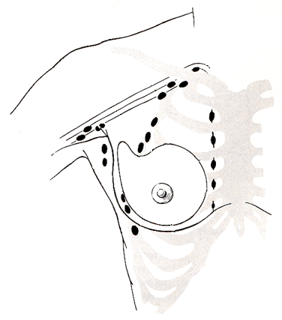
Lymphatic Drainage of the Breast
Mostly drains to axillary nodes (pectoral, apical & central)
to subclavian trunk
Central axillary
Apical axillary
Supra- and Infraclavicular
Lateral axillary
Parasternal
to *thoracic duct (left side only)
Some drainage to para-sternal,supra- & infra-clavicular, extra-peritoneal & mediastinal nodes
to opposite breast
Pectoral
to extra-peritoneal and mediastinal lymph nodes

Slide 17
Physiology
Neonate – enlargement caused by maternal oestrogens
Puberty – oestrogens stimulate growth
Menstrual cycle – follicular phase, oestrogen released causing mammary duct proliferation. In luteal phase, progesterone causes dilatation of mammary ducts
Pregnancy – high oestrogen levels
Breastfeeding – milk production inhibited in pregnancy because of high oestrogen and progesterone which drop during postpartum. Prolactin produced.
Menopause – breast becomes less dense (mammography is easier)

Slide 18
Investigation
Triple Assessment
Examination
Imaging (USS (first line under 35)/Mammography (first line if older as can see breasts better post-menopause))
Biopsy (FNA for cytology/CORE for histology – if suspicious lesion, do core)

Slide 19
Benign Breast Lumps
Fibrocystic breast disease (fibroadenosis)
Most common benign lump
Features: lump/pain/cyst/cyclical variation
No risk of malignancy
Aspirate cysts/no treatment required
Breast cysts
Due to duct obstruction
Multiple bilateral cysts, discrete lump
Well defined opacities on mammography
Needle aspiration (sent for cytology if blood stained)
Can recur, no risk of breast cancer
Fibroadenoma
Most common benign breast tumour, women 15-40yrs
Size may vary with cycle
Mobile lump – from one breast lobule
Core biopsy confirms diagnosis
No treatment necessary/excision if requested or >5cm
Phyllodes tumour
Rare
Rapid increase in size
40-50yrs
Benign/malignant
Excise
Fat Necrosis and haematoma
Blunt injury to breast or anticoagulation patients
May resolve, excision biopsy if diagnosis unclear
Other lumps
Lipoma
Benign fatty tumour
Granuloma
Silicone breast implants/TB
Blocked Montgomery’s tubercles
Blockage of sebaceous gland
Mondor’s Disease
Thrombophelbitis of subcutaneous vein
Give NSAIDs
Galactocele
Caused by closure of milk duct

Slide 20
Nipple Disease
Inverted nipples
Normal or due to breast ptosis/cancer/ectasia (slit like retraction)
Reassure/duct division to stop tethering (breast feeding not possible after this)
Pagets Disease
Caused by DCIS/invasive breast cancer
Malignant
Scaly lesion, unilateral
Tx = mastectomy
Discharge
Often physiological (esp. if bilateral and not bloodstained)
If abnormal features, excise affected duct
Duct papilloma
Benign polyp of ductal epithelium
Most common cause of blood stained discharge
Duct ectasia
Subareolar duct dilation without inflammation
Green discharge with nipple retraction

Slide 21
Breast Pain
Cyclical mastalgia
Pre-menopausal
Associated with fibrocystic breast disease
Hormone driven
Upper outer breast, bilateral, 3-7 days before menstruation
Tx: top NSAID, analgesia, COCP
Non-cyclical mastalgia
Affects older women
Top NSAIDs, avoid surgical intervention

Slide 22
Breast Infection
Mastitis neonatorum
First few weeks of life
Infected enlarged breast bud (staph aureus)
Give abx
Puerperal mastitis
Affects breastfeeding mothers (first 6 weeks) – cracks in breast is entrance for bacteria
Pain, tender, erythema, fevers, rigors
May become abscess
Tx: abx, continue breastfeeding, aspiration

Slide 23
Breast Cancer
One third of all new cancers in women

Slide 24
Pre-malignant
Premalignant change – epithelial hyperplasia with atypia (increase in cell number)
Benign and a type of fibrocystic disease
Detected on mammography
Increased risk of cancer if cell atypia present

Slide 25
Carcinoma in situ
Carcinoma in situ (don’t metastasise)
DCIS (common) - malignant cells in ducts, precursor to invasive disease, confined to ducts so has branching structure, can have microcalcifications, can be low/med/high grade and high are more likely to recur, tx= WLE with 2mm margins, adjuvant radio, mastectomy, SNB if high grade, tamoxifen
Lobular carcinoma in situ – marker of increased risk of breast cancer in either breast (30%), in acini cells become pleomorphic, incidental finding, can be bilateral, tx = if young, mammography surveillance, mastectomy if family history of cancer
Cribriform subtype of DCIS – swiss cheese appearance

Slide 26
Invasive
Invasive
Invasive ductal carcinoma (80%) – hard consistency, adenocarcinoma of ductal elements, most are ‘no specific type’
Rarer subtypes:
Mucoid – cancer cells produce mucus
Medullary - spongy change of breast
Papillary – tiny fingers under microscope
Tubular – small and oestrogen receptor positive
Invasive lobular carcinoma
Less discrete than ductal
Need 1mm margins
Indian file pattern/bull’s eye pattern, higher chance of bilateral cancer
Inflammatory breast cancer
Local invasion of lymphatics cause warm oedematous breast (ie cellulitis like), tx= chemo and mastectomy + ANC
Malignant phyllodes tumour

Slide 27
Risk Factors
Age and Gender
Personal history – ie LCIS, recurrence
Genetic – if relatives diagnosed before age 50/60, need genetics clinic for screening (annual exam with mammography from 35)
BRCA 1 or 2- defunctioning DNA mismatch repair genes
BRCA 1 – chrom 17, autosomal dominant, female breast, ovarian, prostate cancer, high grade and oestrogen/progesterone negative, 70% risk
BRCA 2 – chrom 13, male and female breast cancer, 55% risk
TP53
Li-Fraumeni syndrome
Peutz Jeghers – mutation of tumour suppressor gene
Cowden
Oestrogen Exposure
Endogenous – early menarche/late menopause, nulliparity
Exogenous – OCP, HRT
Environmental
Lifestyle (smoking, alcohol, obesity)
Irradiation
Shift working – low melatonin

Slide 28
Staging
Prognosis: NPI (Nottingham prognostic index – high = good prognosis)
Size
Grade
Nodal status (assessed by CT/SNB via T-99/ANC)
ER Status
If positive, can have tamoxifen
Her2 status
Identified via FISH
If positive, don’t respond to chemo
Lymph invasion
Positive SNB should have ANC

Slide 29
Management
MDT meeting
Breast involvement
Axilla involvement
Distant disease
Adjuvant therapy

Slide 30
Surgery to Breast
First line treatment
Breast conserving – lower psychological morbidity, same rate of survival if clear margins (if not, need mastectomy)
WLE, oncoplastic resection
DCIS can’t have this
Mastectomy
Reconstruction

Slide 31
Surgery to Axilla
Axillary clearance
Level 1 – up to lateral pectoralis minor
Level 2 – up to medial border of pectoralis minor
Level 3 – remove all nodes in axilla

Slide 32
Additional Therapies
Hormonal manipulation
ER+ = tamoxifen (blocks actions of oestrogen, SE = hot flushes, VTE, weight gain) or aromatase inhibitors ie anastrozole (blocks production of oestrogen) or goserelin or ovarian ablation
Radio
All patients with WLE need radio
Local skin reaction, osteonecrosis
Chemo
Reduce tumour size before surgery
METS – bone, liver, lung, brain, adrenals, neck, groin
Neoadjuvant = before surgery
Adjuvant = after surgery

Slide 33
Screening
Follow up = yearly clinic and mammography
50-70years have mammography every 3 years

Slide 34
Male Breast Disease
Breast Cancer
Rare
RF: bilateral undescended testes, Klinefelter syndrome (XXY), BRCA, obesity
Ix as for women
T: mastectomy and ANC – 80% ER/PR positive – given tamoxifen
Gynaecomastia
Uni/bilateral
Benign
Hyperplasia of stromal and ductal tissue caused by increased circulating oesotrogen
Ix: exclude breast cancer
Tx: treat cause (spironolactone, digoxin, amiodarone), can give tamoxifen, surgery

Slide 35
Congenital Abnormalities
Amazia – absence of breast
Athelia – absence of nipple
Polythelia – accessory nipples (found along mammalian line)
Polymastia – accessory breast
Hypoplasia
Poland syndrome – unilateral breast hypoplasia, absence of pectoralis major, webbed fingers

