Slide 1
Evidence Based Surgical Practice

Slide 2
Research and EVIDENCE-BASED MEDICINE

Slide 3
Hierarchy of Evidence
All research starts with a hypothesis
Evidence for a hypothesis: (worst to best)
Case reports
Case series
Cross-sectional studies (observational studies that assess prevalence across given population)
Retrospective studies (observational studies that test hypotheses on aetiology/treatment)
Prospective studies (observational studies that test hypotheses on aetiology/treatment)
Randomised controlled trials (studies that test hypotheses on treatment)
Systematic review of RCTs (meta-analysis)
GOLD STANDARD IS RCT
Blinding – person assessing outcome is unaware of groups, reducing level of bias
Double blinding = participant and assessor are blind
Controls – group of participants not exposed to risk factor/treatment being studied
Must have similar characteristics to other group (matching) so differences are due to factor being studied
Meta-analysis – cumulative test that pools results from all studies to answer a specific question, providing one overall result
Increases power and precision of research
Ie Cochrane review

Slide 4
Evidence-based Medicine
EBM = application of best research evidence
Asking a clinical question
Background questions = general questions about disease
Foreground questions = applicable to an individual
Categories: diagnosis and screening, prognosis, causing harm, treatments
To write a clinical question: PICO (Patient/problem; Intervention/treatment; Comparative treatment; Outcome)
Tracking down the best evidence
Literature searching (PubMed)
Questions about diagnosis answered via cross-sectional studies
Questions about harm answered via cohort study
Questions about prognosis answered via cohort study
Questions about treatment answered via RCTs
Critically appraising the evidence – satisfy yourself and justify to others
RAMBOS (Randomisation, Ascertainment, Measurement, Blinding, Objective, Statistics)
Ascertainment – was the outcome measurement sensible and valid? Ie amount of those lost to follow up
Potential of placebo effect
Statistics –
Diagnosis – likelihood ratios
Prognosis – proportions and confidence intervals
Treatments – absolute and relative risk reduction, numbers needed to treat
Applying the evidence to clinical practice
Evaluate the effectiveness of applying that evidence

Slide 5
Development of Clinical Projects
Ethics
Local ethics committee supervised by main ethics committee, supervised by central ethics committee
Key ethics:
Autonomy – informed freedom of choice
Beneficence – to do good
Non-maleficence – to do no harm
Justice – fair and equal treatment, without bias
Need to consider:
Risk-benefit ratio
Informed consent
Patient confidentiality
Use/storage of human tissue
Aims of study
Funding – doesn’t produce conflict of interests

Slide 6
Basic statistics

Slide 7
Statistics
To get the best out of statistics
Categorise data
Nominal
Ordinal
Metric
Measure the spread
Mode/median/mean
Range, interquartile range, standard deviation, standard error, confidence intervals
Test normal distribution of data (normal vs skewed)
Parametric or non-parametric test?
Test for significant differences (null vs alternative hypothesis)

Slide 8
Study Design
Epidemiological studies:
Observational
Descriptive
Analytical – case control, cohort, cross-sectional
Experimental – RCTs
Incidence = rate of occurrence of a new disease within a population
Prevalence = frequency of a disease in a population at any given time

Slide 9
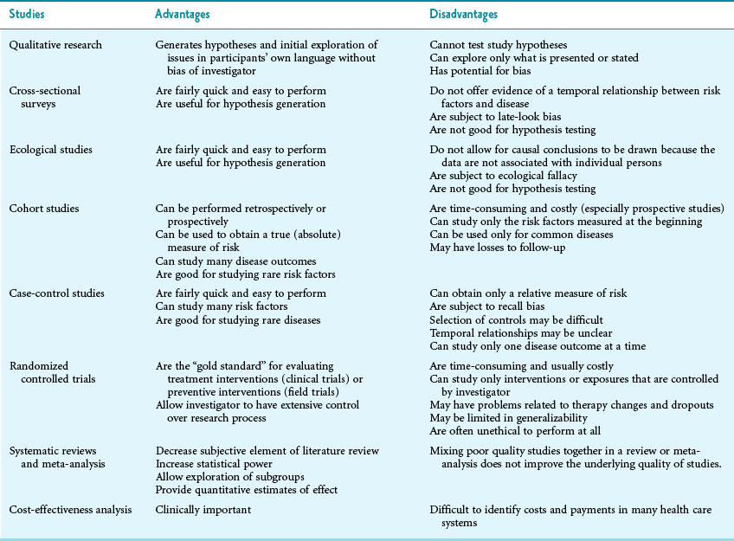

Slide 10
Significance Testing
Construct a null hypothesis (ie no difference exists between the two populations sampled) then test to prove/disprove
If disprove, accept alternative hypothesis (difference exists)
Tested via calculating p value (probability that the null hypothesis is true)
If p is small, null hypothesis is less likely to be correct (if p<0.05, null hypothesis is false)
Testing
Depends on type of data, distribution and data grouping

Slide 11
Types of Data
Categorical variables
Nominal (sex/blood group)
Ordinal (scales) – can be put in logical order but the differences between them are not equal so cannot be averaged (ie average GCS score)
Metric (height, weight) – values with units that relate to each other
Continuous (possible values is infinite)
Discrete (finite values, ie whole numbers)
Once type of data identified, describe in terms of central tendency and spread

Slide 12
Measures of Location
Mode – most commonly occurring value, used to describe categorical variables
Mean – average value within a set of data, used for metric data
Median – middle value after data has been ordered, used with ordinal and metric data and when data is skewed

Slide 13
Measures of Spread
Range – smallest to highest value, used with ordinal and metric
Interquartile range – describes data via 4 quartiles – IQR = numbers that are 25th – 75th quartile
Sensitive to outlying values
Standard deviation – spread of the mean (measure of individual values from their mean), used in metric data
Wider the spread of the data, the greater the distance from mean so the greater the standard deviation
Outliers affect standard deviation
√ (difference² + difference²)
Normal distribution = 95% lie within 1.96 SDs on either side of the mean (99% within 3 SDs)
Standard error of the mean – how good estimate of the mean population value is
large samples give more accurate estimations
SD/√(number of subjects sampled)
More useful when converted to confidence interval

Slide 14
Normal Distribution
Bell shaped curve
Positive skew – curve moves towards 0
Normally distributed data can be analysed using parametric tests, non-normally distributed analysed using non-parametric tests

Slide 15
Selecting a statistical test

Slide 16
Errors
Errors: - used to calculate power of study (1 – type 2 errors)
Type 1 – false positive result (accept 0.05)
Type 2 – false negative result (accept 0.2)
Power calculations are used to calculate the number of samples needed within each group to show a true difference
Done before study started

Slide 17
Bias
Distortion of effects due to systematic difference between two groups
Types:
Observer – intraobserve/interobserver
Selection
Prevalence – study population drawn from special subgroup (not representative of population)
Recall
Information
Publication – positive studies more likely to be published than negative ones

Slide 18
Confounding
Occurs when effect you are measuring is affected by another variable (ie socioeconomic class)
Usually controlled

Slide 19
Statistical Error
Occurs when multiple statistical tests are used
If you do a test 20 times, 1 out of 20 it will be significant by chance
If using multiple tests, correction factor must be applied to all p values to reflect this possibility

Slide 20
Correlation and regression

Slide 21
Correlation and Regression Analysis
Strength of an association between two variables assessed via scatter plot
Correlation – most widely used measure of association between two variables
Strength of association depends on how close points are to line of best fit (all points fall on lie = perfect correlation with correlation coefficient of 1)
Coefficient of 0 = no association between variables
Use Pearsons coefficient if data normally distributed and Spearmans if not
Linear Regression – used to determine nature and direction of casual relationship between variables
Generates mathematical model that uses one/more variables to predict another
Positive correlation
Negative correlation

Slide 22
Survival Analysis
Where recognised end point can be measured
Plot survival curve
Difficulties include loss to follow up and those who opt out of research

Slide 23
Sensitivity and specificity

Slide 24
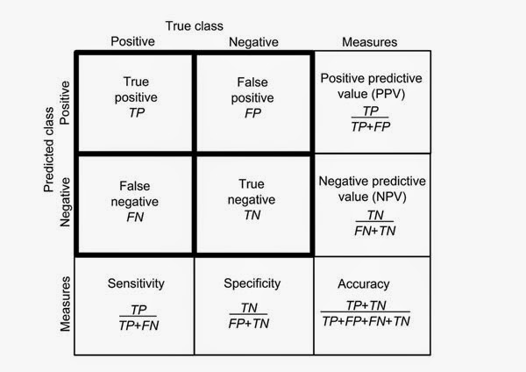
Sensitivity and Specificity
Ability of a test to predict presence/absence of disease
Sensitivity – ability of test to correctly identify people with condition (true positives)
Highly sensitive tests have high rate of detection so if the test is negative, it rules out the diagnosis (SnOUT)
Specificity – ability of test to correctly identify people without condition (true negatives)
Highly specific tests have low false positive rate so if test is positive, it rules in the diagnosis (SpIN)
Positive Predictive Value – proportion of patients that the test identifies as having the condition who actually do have condition
Negative Predictive Value – proportion of patients test identifies as not having condition who don’t have condition

