Slide 1
Perioperative Care

Slide 2
Fitness for surgery

Slide 3
Pre-operative Preparation
Extent of pre-op prep depends on:
Classification of surgery
Elective – mutually convenient
Scheduled – under time limits ie 3 weeks for cancer
Urgent – ASAP after resus within 24 hours
emergency
Nature of surgery (minor/major)
Location of surgery (A+E, endoscopy, theatres)
Pre-op preparation:
Determine fitness for surgery
Anticipate difficulties
Organise facilities, equipment, expertise
Enhance patient safety and minimise errors
Alleviate fear
Reduce morbidity and mortality
Improve mortality by:
Identifying high risk groups pre-operatively
Improved pre-op assessment, triage and preparation (especially fluid balance in acute surgical patient)
Improved intraoperative care
Improved use of post-op resources

Slide 4
Pre-operative Assessment
Done 2-4 weeks prior to surgery
Includes:
History (including past surgical history)
Physical Exam
Investigations
Bloods, urinalysis, ECG, radiology
Consent
High risk patients require anaesthetic review
Some medications stopped prior to surgery

Slide 5
Pre-operative Testing and Imaging
Routine Bloods:
FBC, U+E, Amylase (those with abdo pain), Blood glucose (if known diabetes, abdominal pain or >60), clotting (PT measures extrinsic pathway, APTT measures intrinsic pathway, INR), LFTs (if any symptoms of liver pathology – clotting is more sensitive of liver function), G+S
Urinalysis (if abdo pain)
ECG (if ?cardiac disease)
Radiology – if indicated by history/co-morbidities
Special tests
RA patients need CXR as risk of cervical spinal cord subluxation under anaesthesia

Slide 6
Consent and Counselling
If you don’t know about consent by now, you definitely shouldn’t be a doctor!
Details/options/benefits and risks/post-surgery management

Slide 7
Identification and Documentation
Wristbands for details and allergies

Slide 8
Patient Optimisation
Morbidity and mortality increase in those with co-morbidities
Optimise patients condition
Nutrition
Specialist advice on co-morbidities

Slide 9
Resus of the Emergency Patient
Resus should not delay definitive treatment
Emergency patients are either sepsis/haemorrhage
General principles of resus:
Optimise circulating volume
Correct dehydration (IV fluids with good IV access, catheter to monitor UO)
Correct anaemia (acute = transfuse, chronic is better tolerated)
Treat pain (reduces tachycardia and hypertension)
Antibiotics (empirical until cultures)
Decompress stomach (via NG tube, reduces risk of aspiration on anaesthetic induction)

Slide 10
Prophylaxis
Reduction of known risk
Preoperatively
Stop harmful factors
Stop medications (OCP for a month, aspirin/clopidogrel for 2 weeks)
Stop smoking (even 24 hours improves respiratory function)
Prescribe to reduce risk
Heparin to reduce DVT
Cardiac meds (B blockers/ACEi/statins to reduce cardiac risk)

Slide 11
Pre-operative Marking
Performed after consent to avoid mistakes in theatre

Slide 12
Preoperative management of coexisting disease

Slide 13
Preoperative Medications
Be aware of problems of specific drugs
Steroids/immunosuppressants
Indicated if: pituitary/adrenal insufficiency on steroids, undergoing pituitary/adrenal surgery, on systemic therapy >7.5mg, if on steroids more than 1 month in past 6
Minor use = 50mg hydrocortisone IM/IV
Major use = 100mg hydrocortisone IM/IV with premed, and 100mg every 6 hours for 72 hours post surgery
Complications of steroid therapy: poor wound healing, increased infection risk, sodium and water retention, masking of sepsis, steroid side effects (imparied glucose tolerance, osteoporosis, muscle wasting, peptic ulceration)
Anticoagulants
Risk of thrombosis vs risk of haemorrhage
Warfarin
Inhibits vit-K dependant clotting factors (2,7,9,10), protein C and protein S
Affected by drug interactions
Reversed by Vit K and FFP
STOP 3-5 DAYS BEFORE SURGERY AND REPLACE WITH HEPARIN
INR < 1.2 for open surgery, <1.5 for invasive procesures
Heparin
Binds to antithrombin 3 and inhibits factors 2a, 9a, 10a, 12a
Unfractionated – check APTT every 6 hours and adjust rate
Fractionated (LMWH) – inhibits only factor 10a, given once daily, can be used during pregnancy
Antiplatelets
Decrease platelet aggregation and reduce thrombus formation
Stopped 7-14 days before major surgery
Fibrinolytics (ie streptokinase)
Contraindicated if recent surgery/haemorrhage
Review pre-existing medications
Stop OCP/tamoxifen 4 weeks prior to major/limb surgery (risk of thrombosis)
Stop MAOI antidepressants (interact with anaesthetic – cardiac risk)
Stop antiplatelets 7-14 days preoperatively (risk of haemorrhage)
IV heparin rather than oral warfarin
Prescribe preoperative medications
Pre-existing medications
Prophylactic medications (DVT/antibiotic prophylaxis)
Surgery related medication
Anaesthetic premedication to reduce anxiety

Slide 14
Preoperative Management of Cardiovascular Disease
Surgery split risk of cardiac event (high risk = vascular)
Lee Index predicts individual cardiac risk (history of IHD/cerebrovascular disease/heart failure/T1DM/impaired renal function/high risk surgery) – 3 points = 11% cardiac complications
Investigations
Bloods (FBC, U+E – treat anaemia and electrolyte deficiencies)
Non-invasive test
Assess for MI: ECG (previous infarct, BBB, LVH), exercise testing (gives estimate of functional capacity)
Assess LV function: Echo (ejection fraction), cardiopulmonary testing
Effect of GA:
Decreased systemic vascular resistance
Decreased BP due to tracheal intubation
Myocardial depression

Slide 15
Cardiac Conditions
IHD
Identify risk factors (smoking, hypertension, hyperlipidaemia, diabetes)
NYHA Classfication
Grade 1 = no limitation on activity
Grade 4 = inability to carry out any physical activity, symptoms present at rest
Hypertension
Caused by essential hypertension/pain/anxiety/fluid overload/hypoxia
If diastolic >110, postpone
Check for reversible causes
Valvular Disease
Susceptible to endocarditis – prophylactic antibiotics
AS -ejection systolic murmur radiating to carotids, SAD
MS – diastolic murmur, predisposes to pulmonary hypertension/right heart failure, MUST BE GIVEN ABX
Arrhythmias
AF – disorganised muscle contraction causing irregularly irregular beat, caused by fluid overload/sepsis/ischaemia/alcohol/PE/valvular disease, if acute onset may be reversible, require anticoagulation due to increased thrombotic risk
Pacemakers/ICD
Can interfere with diathermy
Cardiac Failure
Assess exercise tolerance to indicate cardiac reserve

Slide 16
Preoperative Management of Respiratory Disease
Encourage smoking cessation
Reduces oxygen delivery as less binds to Hb
Causes chronic lung disease
COPD/Asthma
Generalised airflow obstruction
Assess baseline lung function via spirometry, ABGs, CXR
Give preoperative salbutamol, avoid high dose opiates (resp depression), chest physio post-op
Hypoxia in perioperative setting - ?inadequate ventilation ?resp depression ?loss of hypoxic drive
TB
Consider residual respiratory capacity
Treat if signs of active infection
Bronchiectasis/CF
Preoperative sputum culture and ABG
Physio and bronchodilators before surgery
Surgical Considerations
Size of incision - upper abdominal wounds cause basal atelectasis as patient doesn’t breathe deeply

Slide 17
Preoperative Management of Endocrine Disease
Diabetes
Avoid hypo/hyper – effects immune response and wound healing
Surgical considerations
Place first on list (reduces period of starvation and risk of hypo)
Protect pressure areas
Assess HbA1c
Continue oral hypoglycaemic drugs until morning of surgery (metformin stopped 48 hours in advance due to risk of metabolic acidosis)
Sliding scale after surgery and restart normal regimen when can eat and drink
T1DM – start of sliding scale on morning of surgery
Thyroid
Hyper – thyroid crisis can be precipitated by surgery (excessive thyroxine release causing hyperthermia and cardiac arrhythmia)
Hypo – low cardiac output so causes MI, hypotension, hypothermia
Parathyroid
Hyper
Primary – secretory parathyroid adenoma
Secondary – parathyroid hyperplasia due to chronic hyperstimulation
Tertiary – autonomous hypersecretion
Causes increased calcium and decreased phosphate
Hypo – decreased calcium and increased phosphate

Slide 18
Preoperative Management of Neurological Disease
Epilepsy
Avoid seizures in perioperative period by minimising medication disruption
Cerebrovascular Disease
Avoid BP changes – manage fluids carefully
Give heparin
Delay elective surgery if recent CVA
Parkinson’s Disease
Reduced dopaminergic activity in substantia nigra
Tremor, postural instability, rigidity, dyskinesia
Time medications – on and off periods
Domperidone as antiemetic as no antipyramidal effects

Slide 19
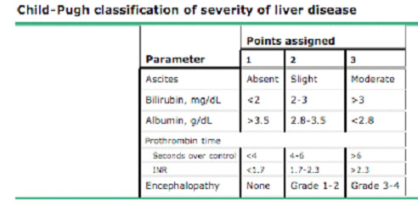
Preoperative Management of Liver Disease
Problems:
Bleeding due to coagulopathy
Encephalopathy
Increased risk of infection/renal failure
Hypoglycaemia
Acid base/electrolyte imbalances
Jaundice
Fluid balance – hypoalbuminaemia and fluid overload are common as well as sodium retention
Acid-base balance – metabolic and respiratory alkalosis can occur and will decrease oxygen delivery to tissues
Clotting – decrease vit K absorption in cholestatic jaundice, reduced synthesis of clotting factors
Hepatorenal syndrome
Drug metabolism – drugs metabolise in liver and may have prolonged duration of action in liver failure, hypoalbuminaemia impairs drug binding and may increase serum levels
Hypoglycaemia due to decreased glycogen stores
Cholestatic jaundice
Try to treat
Hydration
Check PT and give Vit K within 2 hours of surgery
Abx to prevent cholangitis
Chronic Liver Failure – Child’s Classification
Fluid and electrolyte management – low serum sodium may have high total sodium due to secondary aldosteronism)
Ascites (drainage)
Prevent encephalopathy – give metroniadazole and regular lactulose
Coagulopathy – give vit K
Nutritional support
Alcohol withdrawal – symptoms occur at night, chlordiazepoxide regimen

Slide 20
Preoperative Management of Renal Failure
Acute
Pre – haemorrhage, burns
Renal – diabetes, glomerulonephritis
Post - obstruction
Chronic
Requires dialysis
Fluid monitoring
Problems
Fluid and electrolyte balance – fluid overload
Hypoalbuminaemia (nephrotic syndrome)
Metabolic acidosis
Drug metabolism/excretion
Avoid nephrotoxic drugs if impaired function

Slide 21
Preoperative Management of Rheumatoid Disease
RA
Progressive joint swelling and deformity
Increased risks
Risk of valve disease
Anaemia of chronic disease
Respiratory – pleural nodules/fibrosis
Renal impairment due to nephritis or medication
Poor wound healing
C spine – predisposing to atlantoaxial subluxation

Slide 22
Management of Nutritional Status
Decreased intake
Impaired digestion
Increasingly catabolic states (due to disease processes/malignancy/major surgery)
Assess BMI
Daily requirements – GET TABLE
Malnutrition
Starvation that induces low grade inflammatory state which causes tissue wasting and impaired organ function
Causes poor wound healing, immunocompromise and infection, organ failure
Obesity
Surgical risks
Respiratory – decreased chest wall compliance and shallow breathing predisposes to atelectasis, increased oxygen consumption due to increased metabolic demand, sleep apnoea
Aspiration
Wound healing – increased adipose tissue predisposes haematoma formation
Technical – surgery takes longer and may have access problems
Nutritional Support
Tailored to protein/calorific/nutrient need
Oral → enteral tube (NG/NJ/PEG) – tube may displace and risk of aspiration → parenteral (via venous access PICC)
Nutritional Planning
Dietician assessment
Post-op complications
Colorectal surgery - NBM →sips → free fluid → diet
Upper Gi surgery – feeding jejunostomy may be needed

Slide 23
Risk Factors and Scoring
POSSUM score – to assess morbidity/mortality risk
ACPGBI – mortality for colorectal cancer resection

Slide 24
Principles of anaesthesia

Slide 25
Local
Works by altering membrane permeability and prevent passage of nerve impulses
Avoids risk of general anaesthetic
Doses: 0.5% = 5mg/ml, 1% = 10mg/ml etc
Should be used at lowest concentration and warmed to body temperature to decrease pain on injection
When mixed with adrenaline, slowed systemic absorption and prolonged duration of action
Examples:
Lidocaine (3mg/kg) – nerve blocks/epidurals
Prilocaine (6mg/kg) – regional nerve blocks
Never use local anaesthetic contained adrenaline near end arteries as can cause necrosis
Topical – used for superficial anaesthsia
Advantages:
Reduced side effects (compared to GA)
Good depth in area
No need for mechanical ventilation (no atelectasis risk)
Can be used with reduced level of GA
Can be continued post-op for analgesia
Decreased risk of DVT
Complications
Toxicity (local inflammatory response or systemic allergy causing tingling, seizures, cardiovascular collapse)

Slide 26
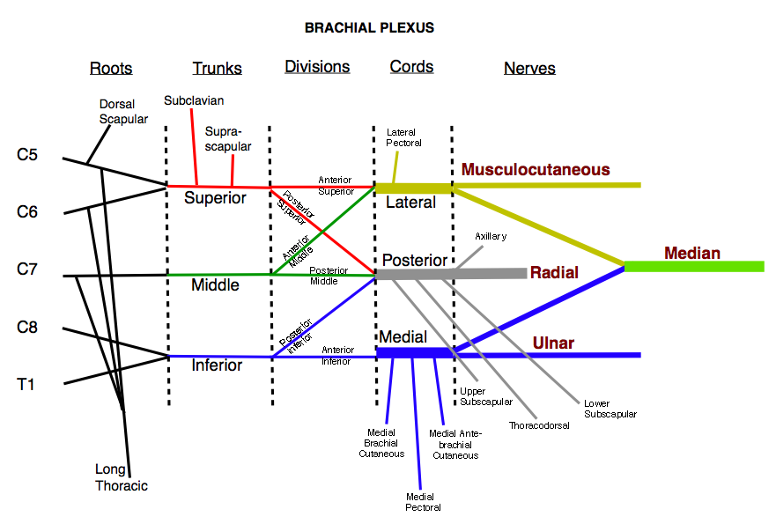
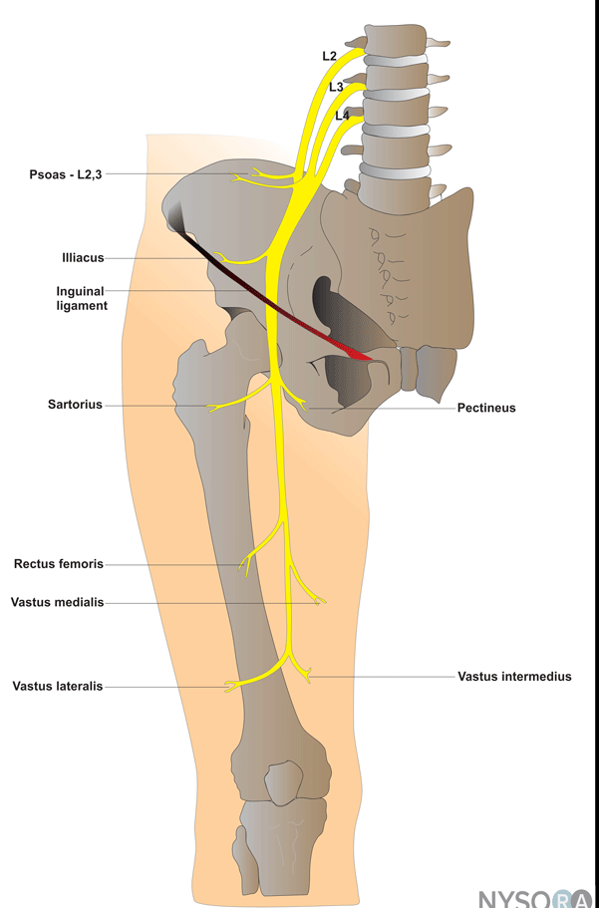
Regional
Field block – anaesthesia of entire surgical field; ie blocking a nerve
Ring block – type of field block of digits/penis where LA injected into either side of proximal phalanx; used for digit manipulation
Never use adrenaline!
Brachial plexus block – brachial plexus formed for C5-T1 roots
Interscalene blocks (trunks)
Supra/infra clavicular (divisions)
Axillary block (cords)
Femoral block – femoral nerve arises from L2-4 and passes on posterior wall between psoas and iliacus and passes under inguinal ligament and divides in the femoral triangle, lies 1 cm lateral to femoral artery; provides anaeasthsia to anterior thigh, knee and femur
Sciatic block – arises from L4-S3, block can be done lateral/anterior/posterior and suitable for ankle/foot surgery
Biers block – upper limb
Intercostal nerve block – useful for invasive procedures (chest drain), insert needle just below edge of posterior rib; risk of pneumothorax
Spinal anaesthesia – lower abdo, perineal and lower limb surgery
Contraindicated in those anticoagulated/septic/previous back surgery
Complications: toxicity, hypotension, meningism, urinary retention
Epidural anaesthesia – feed catheter into extradural space
Complications – dural tap, backache, infection, haematoma
Level described via dermatome
High block (C4) may cause resp depression

Slide 27
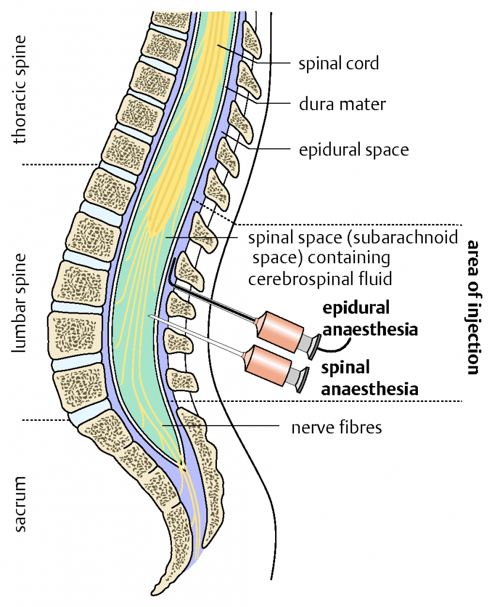

Slide 28
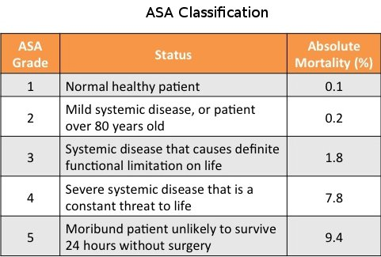
Sedation
Administration of drug to alleviate discomfort during interventions, with maintenance of patient responsiveness and protective reflexes and can obey verbal commands
Don’t sedate high risk patients (elderly)
Monitor carefully (cardio/resp/CNS)

Slide 29
General
Induces narcosis/analgesia/muscle relaxation in reversible manner so patient has no recollection of experience
Stages:
pre-op assessment
ASA grading
Premedication to sedate, cause amnesia, antiemetic, increase vagal tone,
Benzos – sedative, anxiolytic and amnesic (midazolam, temazepam, diazepam)
Opioids
Anticholinergics
Antacids – prevent aspiration of gastric contents
induction and muscle relaxation
Agents for Induction
Thiopental sodium – rapid induction but small therapeutic window and overdose causes respiratory depression, can’t be used with laryngeal airways
Propofol – has added antiemetic effect, gives rapid recovery, lower incidence of laryngospasm
Etomidate – better in unstable cardio patients
Complications:
Hypotension, resp depression, laryngeal spasm, allergic reactions, tissue necrosis
Muscle relaxants
Depolarising (suxamethonium) – maintain muscle in depolarised state
Non-depolarising (atracurium, vecuronium) – longer duration
maintenance and monitoring
Inhalation anaesthetics used for maintenance of anaesthesia and in children
Halothane/enflurane/isoflurane/sevoflurane/nitrous oxide
Contraindications – risk of malignant hyperthermia
Monitoring – arterial pressure, ECG, gas mixture analysis, tidal volume, capnography
recovery
post-op monitoring

Slide 30
Complications of General
Problems with intubation
Sore throat due to tube
Trauma to mouth
May need alternative airway if intubation fails
Problems with anaesthetic drugs
Anaphylaxis
Malignant hyperpyrexia – hyperthermia, muscle rigidity, DIC, tachycardia, tachypnoea, give dantrolene sodium 1mg/kg
Nausea and vomiting – antiemetics
Drowsiness
Cardiovascular complications
MI
Hypo/hyper tension
Arrythmias
Respiratory complications
Airway obstruction – laryngeal spasm/oedema
Hypoventilation and hypoxia – reduced respiratory drive due to sedative drugs, elevated abdominal pressures
Gastric aspiration – due to raised abdominal pressure, delayed gastric emptying
Reduce risk by no solids for 6 hours before, NBM 4 hours before, NG tube
Residual neuromuscular blockade

Slide 31
Care of the patient in theatre

Slide 32
Patient Care
Preoperative checks
Identify via wristband (WHO checklist)
Preventing injury to anaesthetised patient
General
Transferring patients to operating table
Positioning of patients for duration of surgery
Specific
Oral cavity injury during intubation
Use of diathermy/laser/tourniquet
Pressure area injury – use of padding to prevent (sacrum, heel, back of head)
Joint/nerve/skin/muscle/eye injuries
Preserving patient dignity

